Slide 1
Tesla RAG System
Retrieval-Augmented Generation for Policy & Product Knowledge Assistant
Built with: FAISS, Sentence-Transformers, Groq LLM, Streamlit
Author: Tamanna Yadav

Slide 2

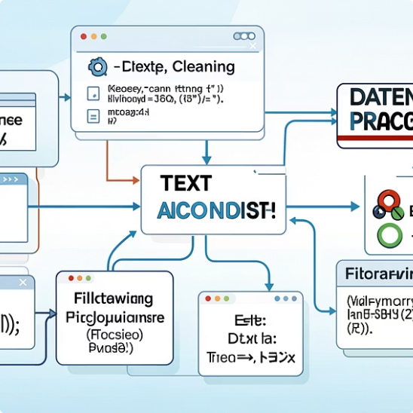

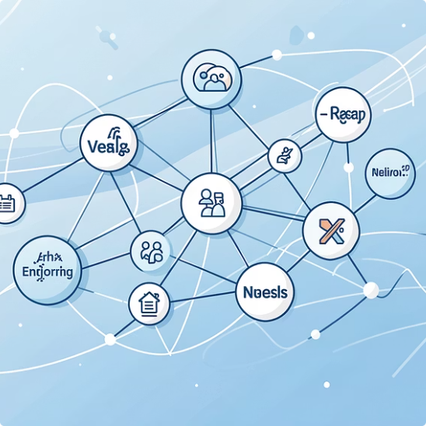
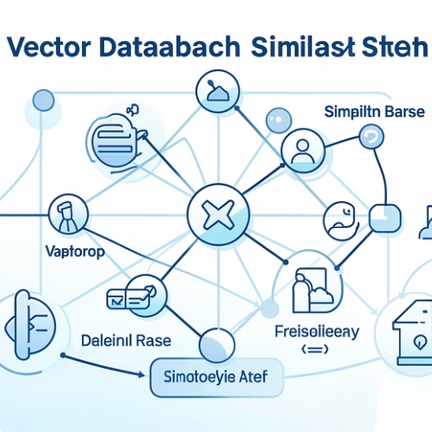

System Architecture Overview
Ingestion Layer
Preprocessing
Chunking Strategy
PDF extraction using pdfplumber for precise text capture from Tesla documentation
Text cleaning and normalisation ensure consistent, high-quality input for embedding generation
Recursive splitter with 512 characters per chunk and 50-character overlap maintains context continuity
Embeddings
Vector Database
Generation Model
all-MiniLM-L6-v2 generates 384-dimensional vectors for semantic similarity search
FAISS with cosine similarity enables lightning-fast retrieval from 615 indexed chunks
Groq Llama 3.3 70B Versatile produces high-quality, contextually grounded responses

Slide 3
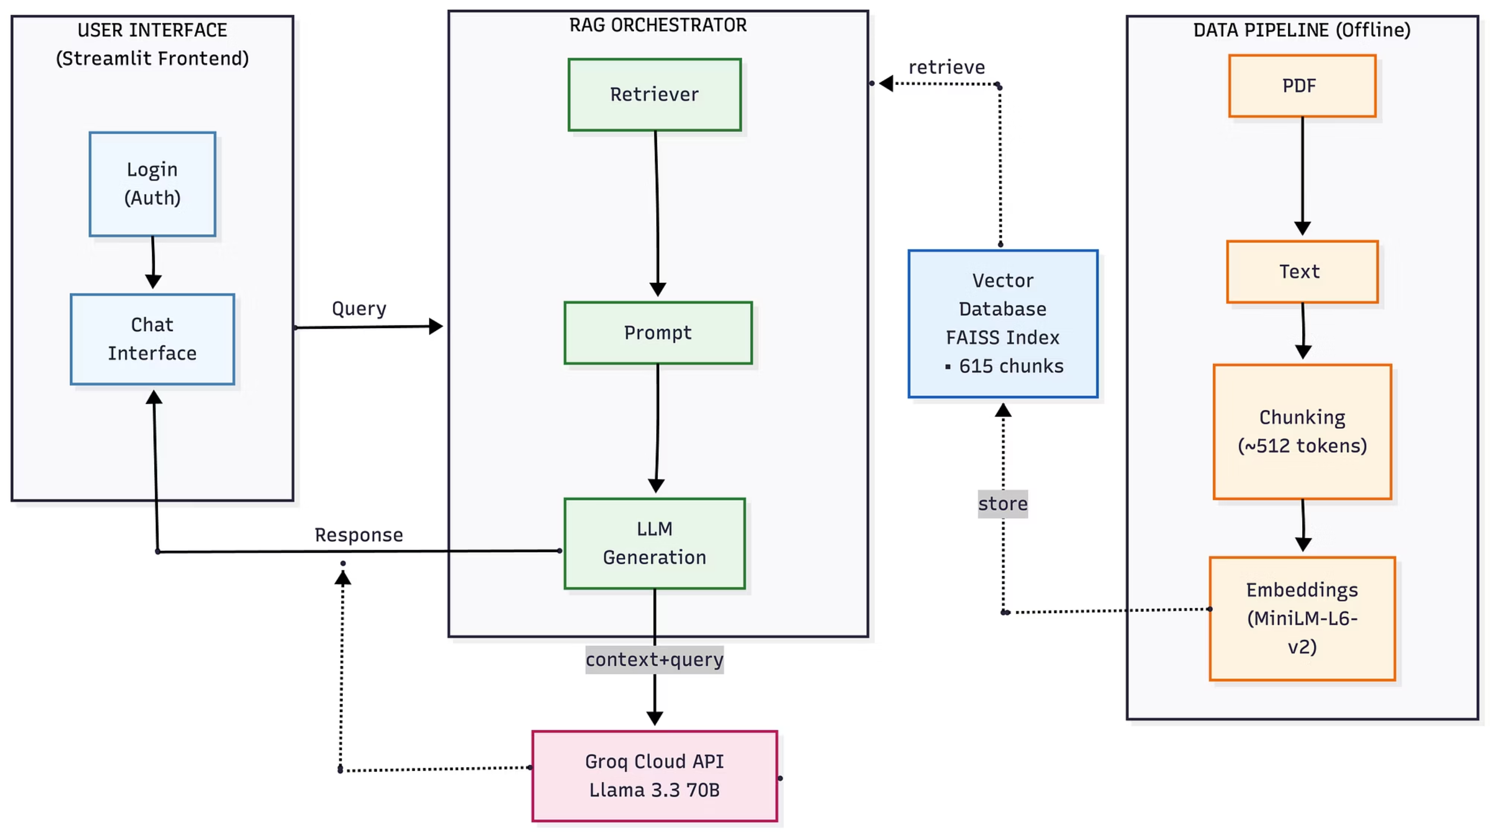
Architecture Diagram

Slide 4

Hybrid Architecture: SLM + LLM
My system leverages a strategic hybrid approach that combines the speed of small language models with the reasoning power of large language models, optimising for both performance and quality.
Why Groq Llama 3.3 70B?
01
02
Fastest Inference
Cost-Effective
Hardware-optimised LPU architecture delivers industry-leading speed
Free tier enables development without budget constraints
03
04
70B Parameters
Extended Context
Excellent reasoning and instruction-following capabilities
Large context window handles multiple retrieved chunks effectively
Component
Choice
Reasoning
Embedding Model
all-MiniLM-L6-v2 (SLM)
Fast, 384 dimensions, runs locally, excellent for semantic search
Generation Model
Llama 3.3 70B (LLM)
High-quality responses, handles complex queries with superior reasoning

Slide 5




LLM vs SLM: Strategic Trade-offs
Understanding the strengths and limitations of small versus large language models informed my architectural decisions. Each model type excels in different dimensions, making the hybrid approach optimal.
Inference Speed
Cost Structure
Response Quality
Deployment
SLM: Lightning-fast local execution with minimal latency
SLM: Free or minimal cost for local deployment
SLM: Limited reasoning and contextual understanding
SLM: Local or edge deployment with minimal infrastructure
LLM: Slower inference due to model size and complexity
LLM: API costs scale with usage volume
LLM: Superior quality with advanced reasoning capabilities
LLM: Cloud-based deployment requires robust infrastructure
SLM for Embeddings
LLM for Generation
Optimal Result
MiniLM runs locally with no API calls, enabling rapid retrieval operations
Groq's Llama 3.3 70B delivers high-quality, contextually grounded responses
Fast retrieval combined with premium generation quality

Slide 6


RAG vs Base LLM: Evaluation Results
Our comprehensive evaluation demonstrates that retrieval-augmented generation significantly outperforms base LLM approaches across critical metrics. The RAG system's ability to ground responses in actual Tesla documentation translates to measurably better performance.
Reduced Hallucination
Traceable Answers
Strong Retrieval
RAG reduces hallucination by 37% (0.201 vs 0.320) by grounding answers in actual Tesla documents rather than relying on potentially outdated training data
Faithfulness score of 0.396 ensures every claim can be traced directly to source documents, whilst base LLM shows 0.0 grounding
MRR of 0.500 indicates relevant documents consistently appear in top 2 positions, with ROUGE-L of 0.215 showing good textual overlap
37%
Metric
RAG System
Base LLM
Winner
Improvement
Answer Relevance
0.980
1.000
Tie
—
Hallucination Reduction
Faithfulness
0.396
0.000
RAG
∞
Hallucination Risk
0.201
0.320
RAG
37% lower
ROUGE-L
0.215
0.000
RAG
∞
MRR
0.500
0.000
RAG
∞
50%
MRR Score
Top-2 retrieval

Slide 7


Why RAG Outperforms Base Models
Base LLM Limitations
RAG System Advantages
Large language models operating without retrieval mechanisms face fundamental constraints that limit their effectiveness for enterprise knowledge systems.
Our retrieval-augmented approach fundamentally transforms how the system accesses and utilises information, delivering superior reliability.
01
Knowledge Cutoff
Hallucination Risk
Active Retrieval
Relies solely on training data with fixed knowledge cutoff dates
May fabricate specific Tesla policies or technical specifications
Retrieves relevant chunks from current Tesla PDFs in real-time
02
Generic Knowledge
No Grounding
Document Grounding
Lacks Tesla-specific details and proprietary information
Cannot verify claims against actual source documents
Answers grounded in actual, verifiable Tesla documentation
03
Source Attribution
Cites specific sources with page numbers for transparency
04
Reduced Hallucination
37% lower hallucination risk through factual grounding

Slide 8
Technical Specifications
Core System Configuration
Dataset Overview
Our carefully tuned parameters balance retrieval quality, generation accuracy, and system performance across the entire RAG pipeline.
7
615
Parameter
Value
PDF Documents
Indexed Chunks
Chunk Size
512 characters
Tesla source files
Searchable segments
Chunk Overlap
50 characters
Our comprehensive dataset spans multiple document types to provide broad coverage of Tesla knowledge:
Embedding Model
all-MiniLM-L6-v2
Privacy Policy documentation
Terms of Service agreements
Owner's Manual technical specs
Impact Report sustainability data
Embedding Dimension
384
Vector Store
FAISS (Flat Index)
Similarity Metric
Cosine Similarity
Top-K Retrieval
5 chunks
LLM
Llama 3.3 70B Versatile
Temperature
0.1 (low for factual)
Top-P
0.9

Slide 9
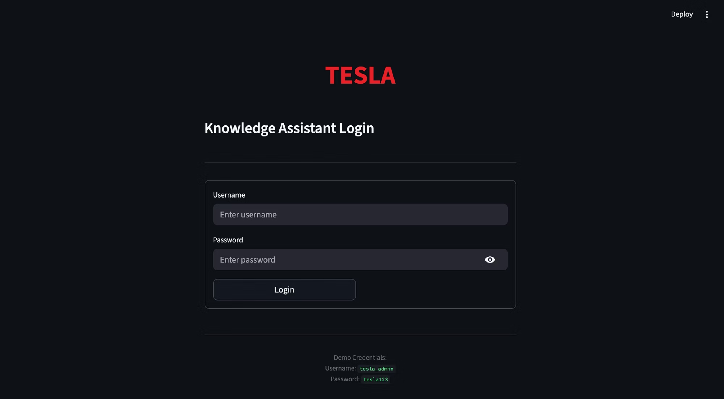
Streamlit Application
1. Login Page

Slide 10
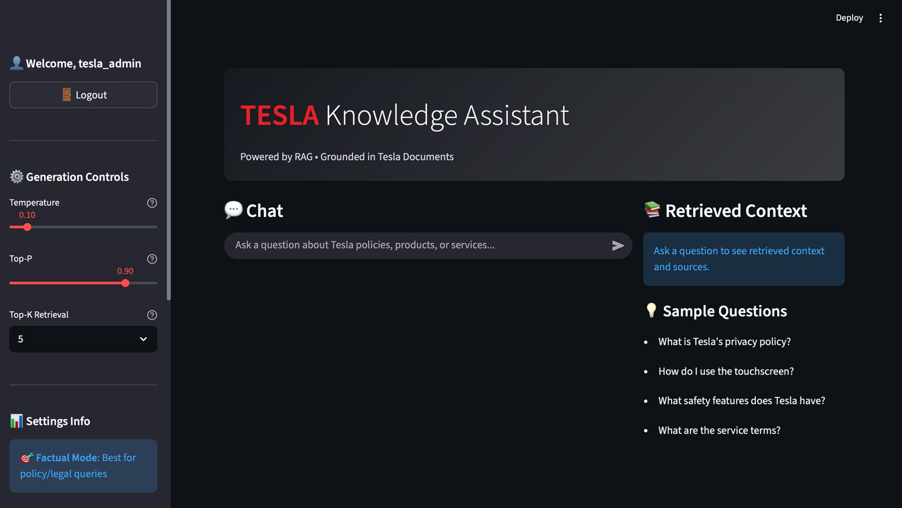
2. Home Page

Slide 11
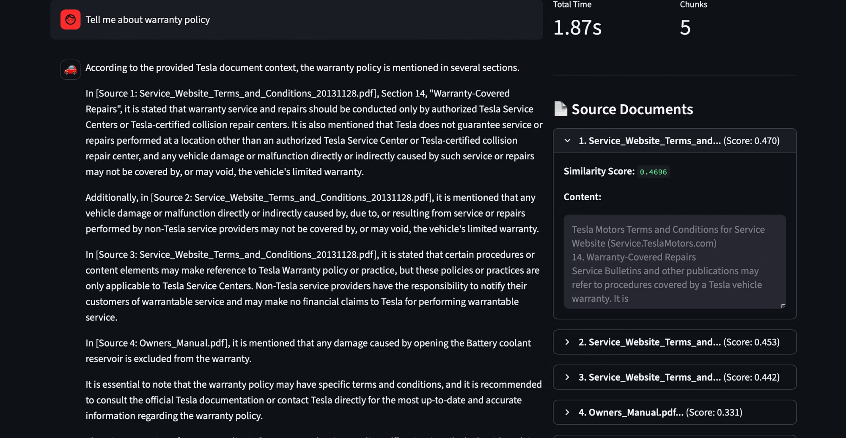
3.Query -response along with source documents

Slide 12
Conclusion
Summary
✅ Built a complete RAG system for Tesla knowledge base
✅ Hybrid SLM + LLM architecture for optimal performance
✅ 37% reduction in hallucination risk vs Base LLM
✅ Interactive Streamlit frontend with authentication
✅ Comprehensive evaluation framework
Key Takeaway:
"Grounding matters. RAG ensures answers are traceable to actual Tesla documents, making it safer and more reliable for enterprise use."

